Slide 1
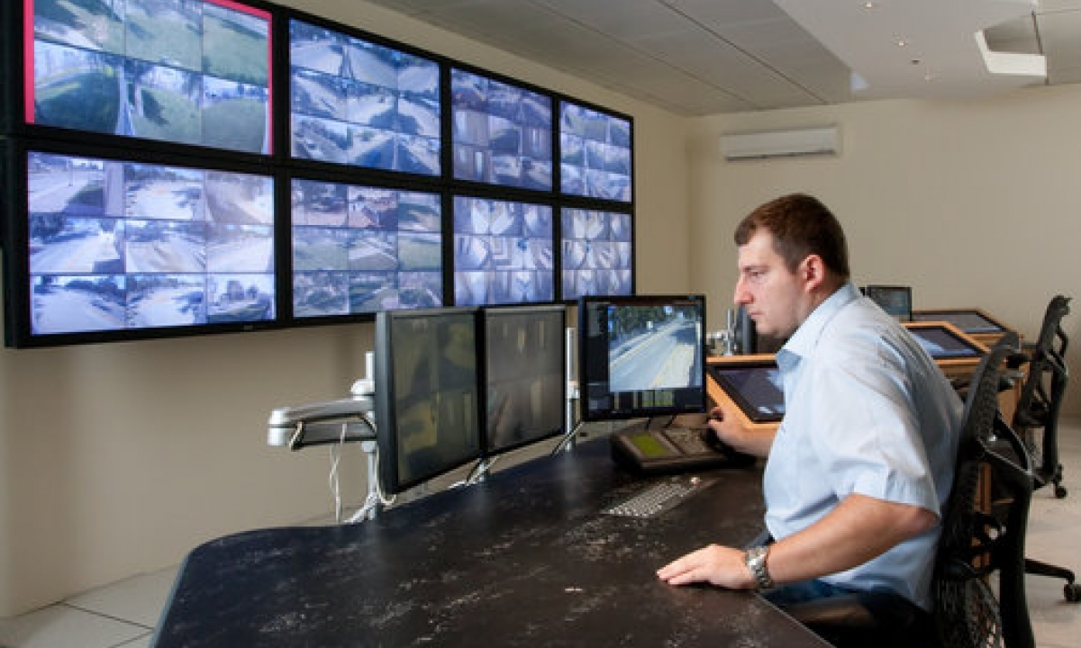

PROBLEM STATEMENT
0‹#›

Slide 2
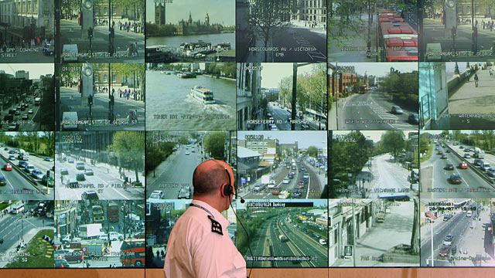
PROBLEM STATEMENT
0‹#›

Slide 3
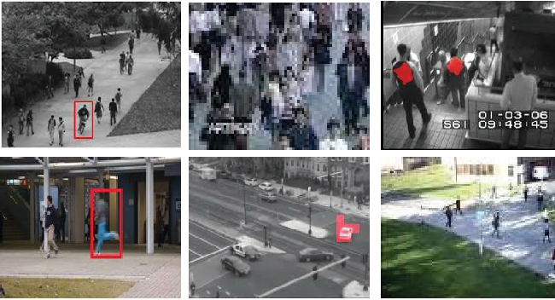

ANOMALY DETECTION IN VIDEOS
DATASETS
USED
0‹#›

Slide 4
PROBLEM MODELING
0‹#›

Slide 5




PYTHON PACKAGES
‹#›

Slide 6
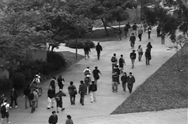
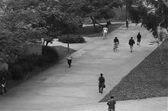
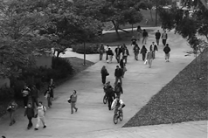
The UCSD pedestrian Dataset
DATASETS
USED
The UCSD pedestrian Dataset
The ShanghaiTech dataset
The CUHK Avenue dataset
A stationary video camera with a resolution of 238 X 158 pixels.
Recorded at a frame rate of 26 frames per second.
The Ped 1 dataset includes 34 train and 36 test video samples.
‹#›

Slide 7
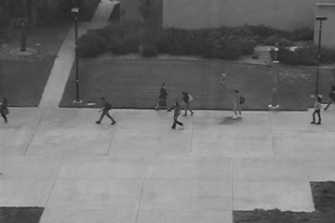
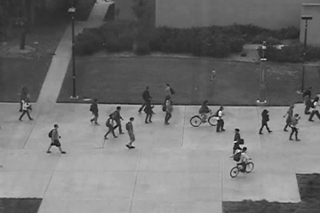
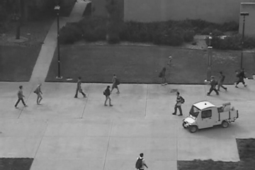
The UCSD pedestrian Dataset
DATASETS
USED
The UCSD pedestrian Dataset
The ShanghaiTech dataset
The CUHK Avenue dataset
A stationary video camera with a resolution of 238 X 158 pixels.
Recorded at a frame rate of 26 frames per second.
The Ped 2 dataset contains 16 train and 12 test video samples.
‹#›

Slide 8
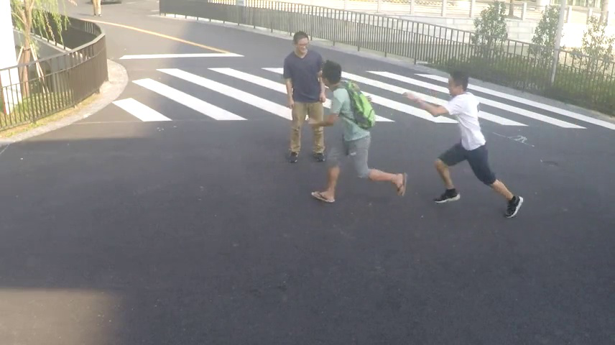

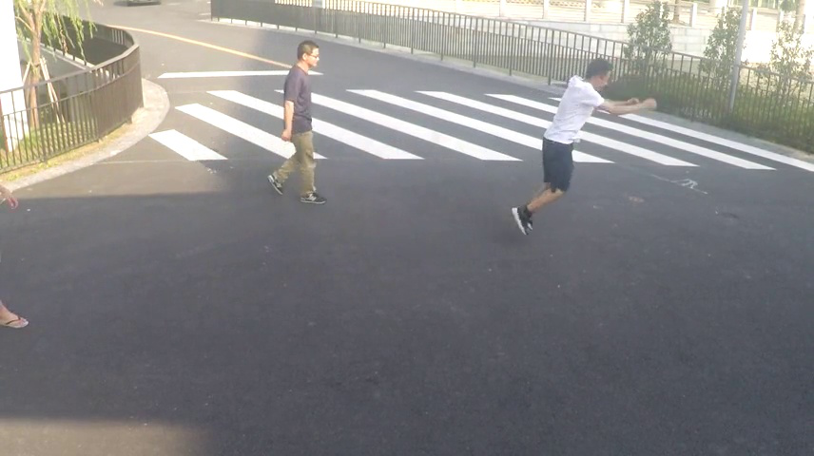
The ShanghaiTech dataset
DATASETS
USED
The UCSD pedestrian Dataset
The ShanghaiTech dataset
The CUHK Avenue dataset
It includes footage from 13 various cameras located throughout the ShanghaiTech University campus.
It contains about 270, 000 training frames and 130 anomalous events.
‹#›

Slide 9
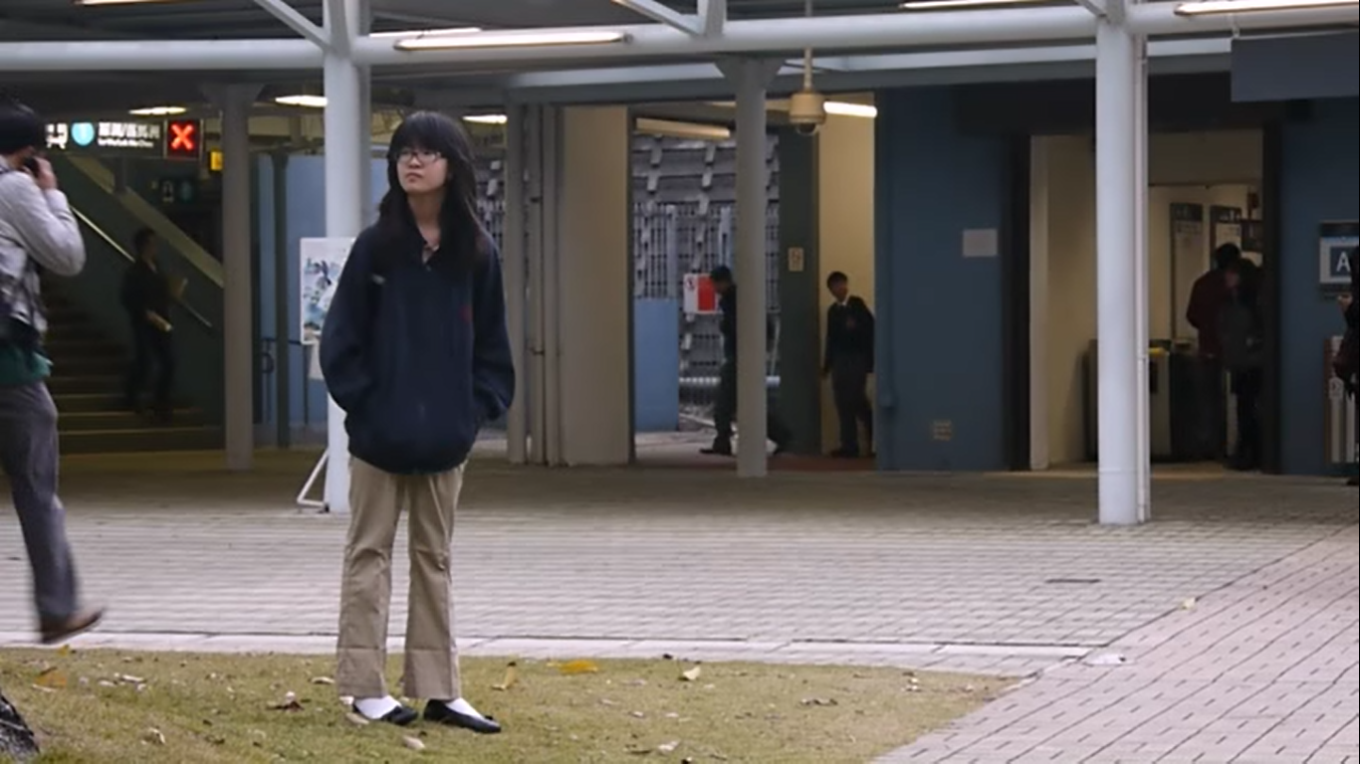
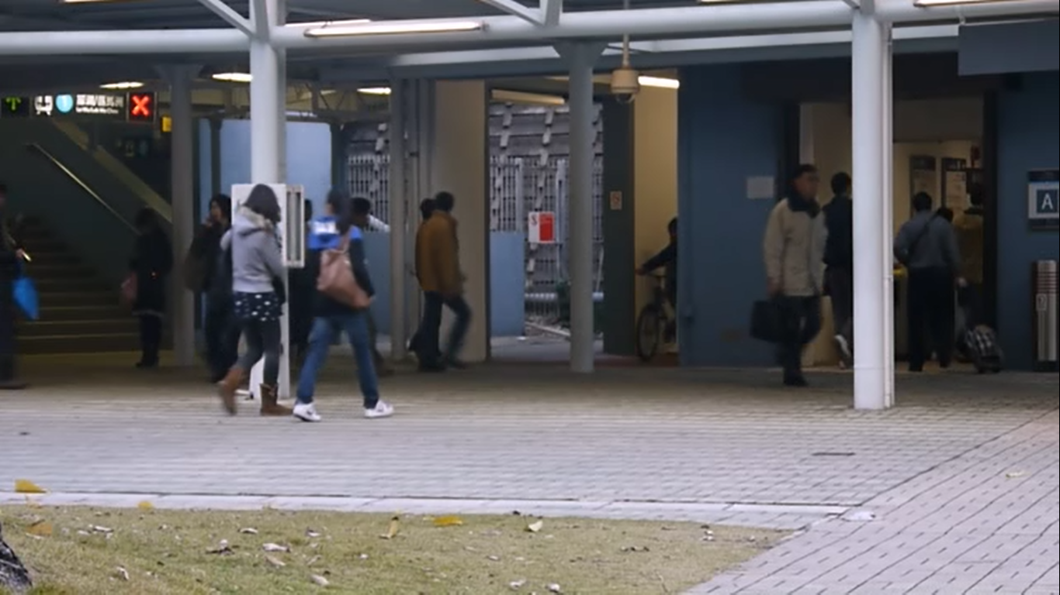
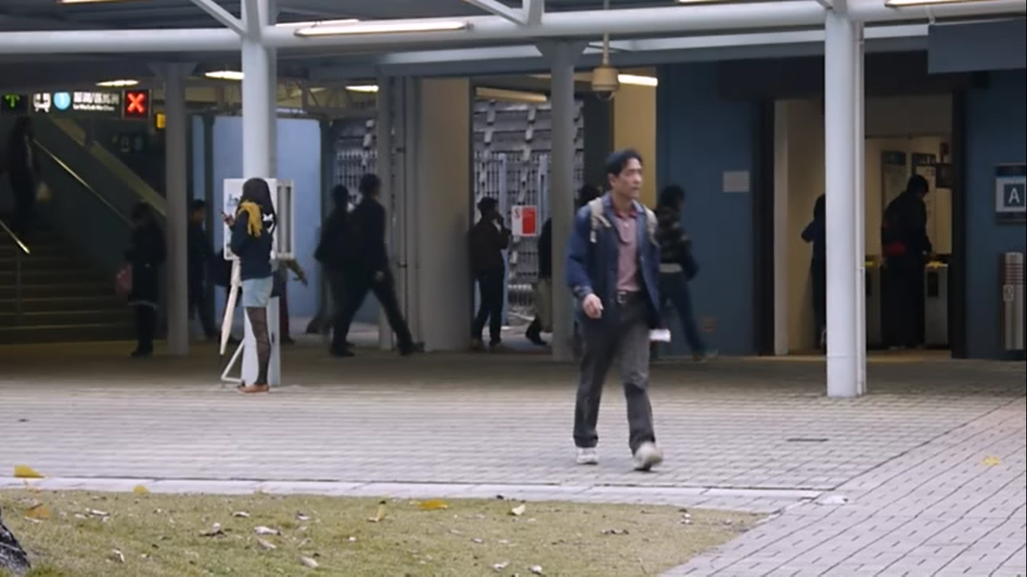
The CUHK Avenue dataset
DATASETS
USED
The UCSD pedestrian Dataset
The ShanghaiTech dataset
The CUHK Avenue dataset
created by filming street activities at the Chinese University of Hong Kong
A stationary camera with a resolution of 640 X 360 pixels.
Contains 16 train video examples and 21 test video samples.
‹#›

Slide 10
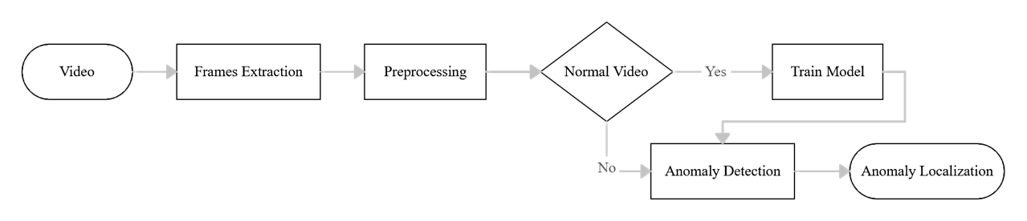
PROJECT’S PIPELINE
DATASETS
USED
‹#›

Slide 11
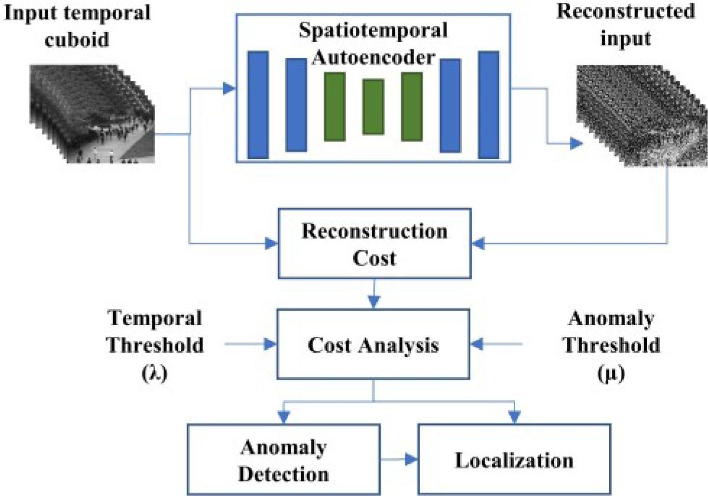
OUR
SOLUTION
‹#›

Slide 12
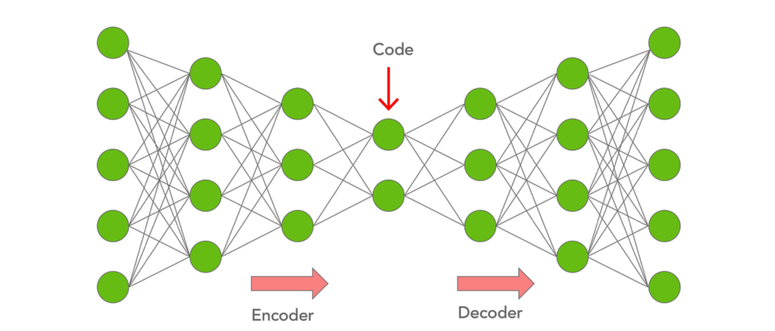
AUTO-ENCODER
‹#›

Slide 13
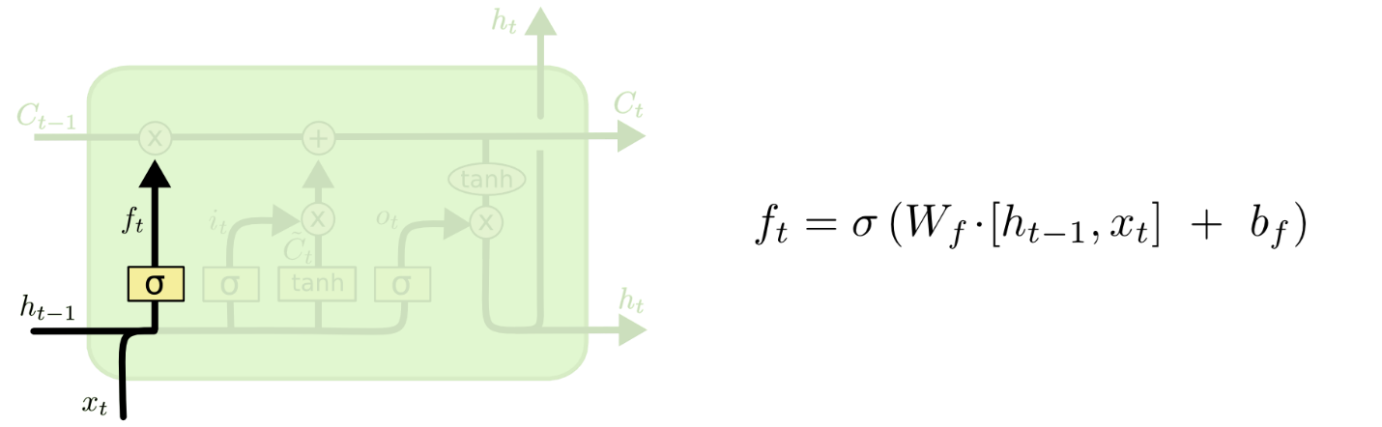
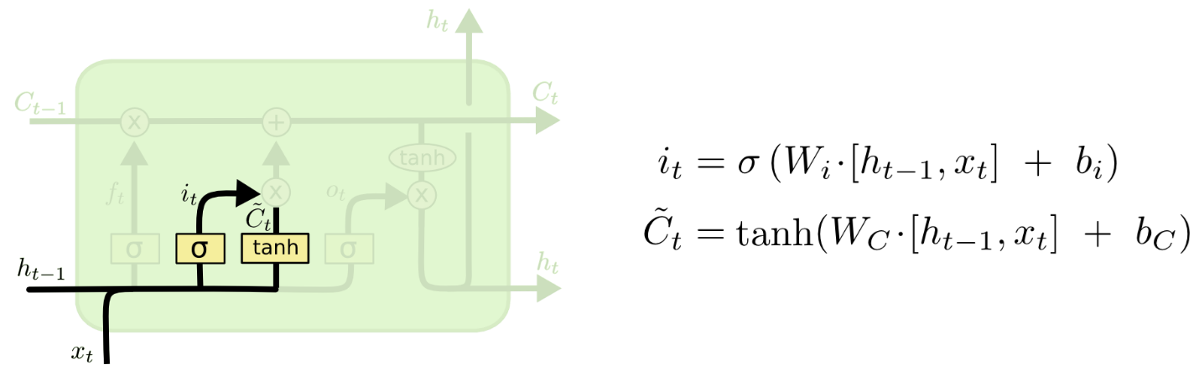
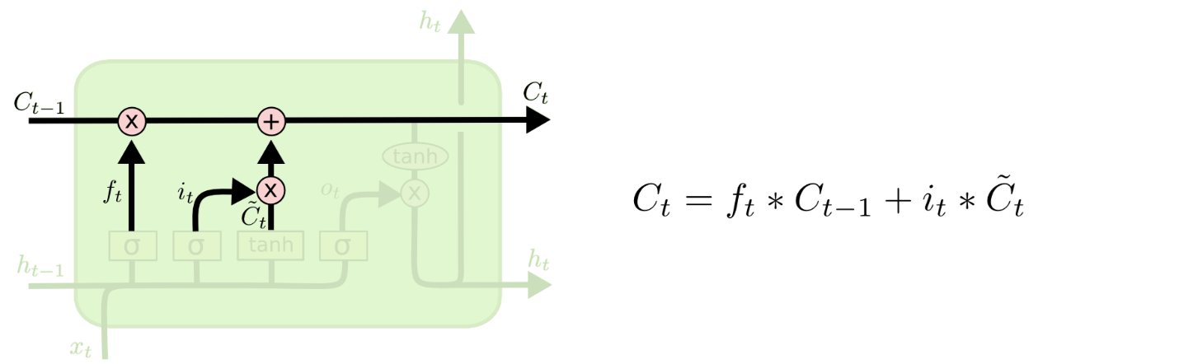
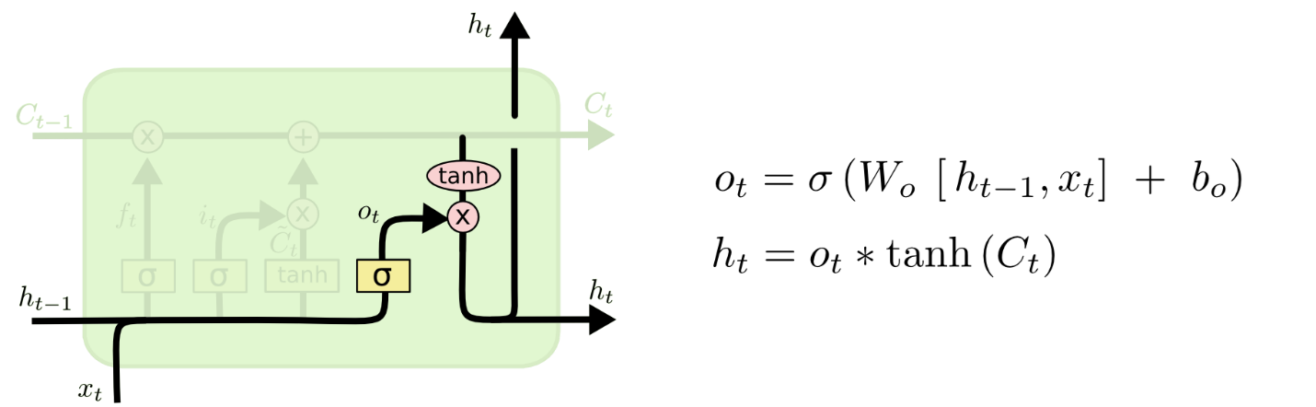
LONG AND SHORT TERM MEMORY
DATASETS
USED
‹#›
Notes:
The second technique is Long Short-Term Memory (LSTM) networks are a sort of Recurrent Neural Network (RNN) that are able of learning order dependence in sequence prediction tasks.

Slide 14
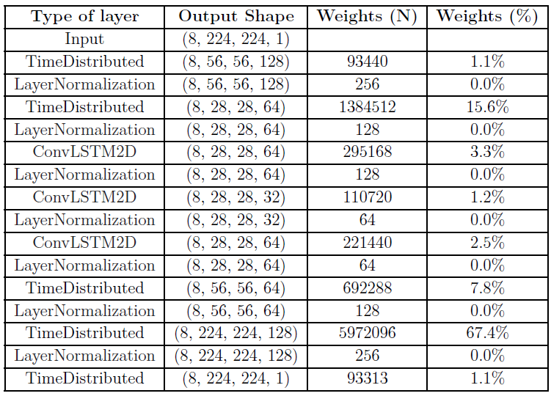
MODEL
ARCHITECTURE
‹#›

Slide 15
EXPLORING EXPERIMENTAL RESULTS
‹#›

Slide 16
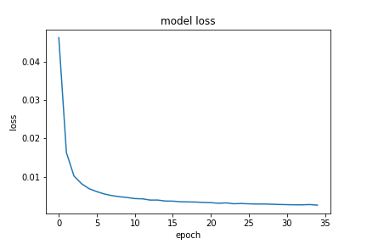
MODEL TRAINING
‹#›

Slide 17
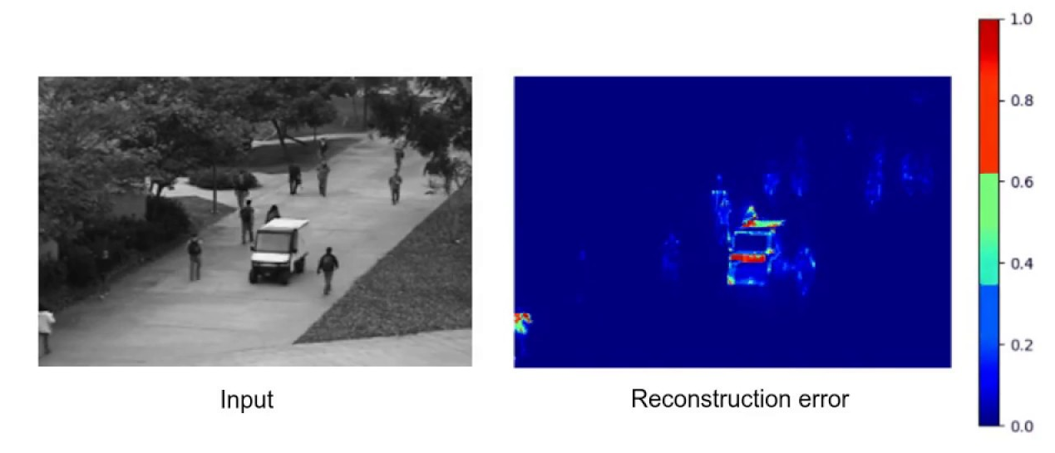
TEST OUR MODEL
‹#›

Slide 18
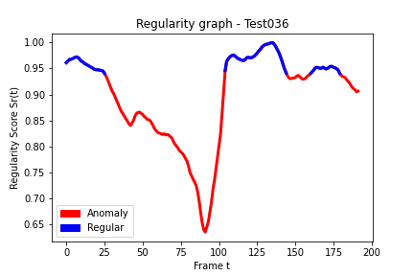
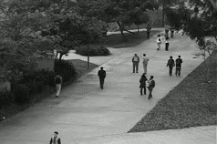
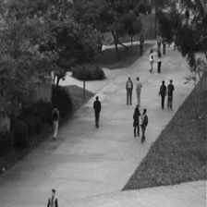
TEST OUR MODEL
‹#›

Slide 19
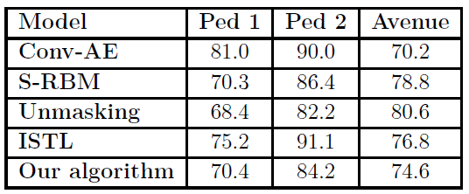
COMPARISON
Comparison of AUC
‹#›

Slide 20
CONCLUSION
‹#›

Slide 21
Our model is based on the spatiotemporal auto-encoder.
Our model does not only detect anomalies but also can localize them in the spatial reference.
Despite the low available computational resources, our model achieved good results.
CONCLUSION
‹#›

Slide 22
Minimize the prediction serving latency
Enhance quality of results
Use active learning technique
Real-time anomaly detection
PERSPECTIVES
‹#›

Slide 23
THANK YOU
‹#›

